Slide 1
NETWORK PROVIDER DATABASE MANAGEMENT SYSTEM
TEAM MEMBERS | NU ID
SRUTHI BHASKAR | 002791003
NIHARIKA VITTAL | 001523748
SOUMYA RAYAPPANOR | 002747973
Project Demo
December 10, 2022

Slide 2
ER Diagram

Slide 3
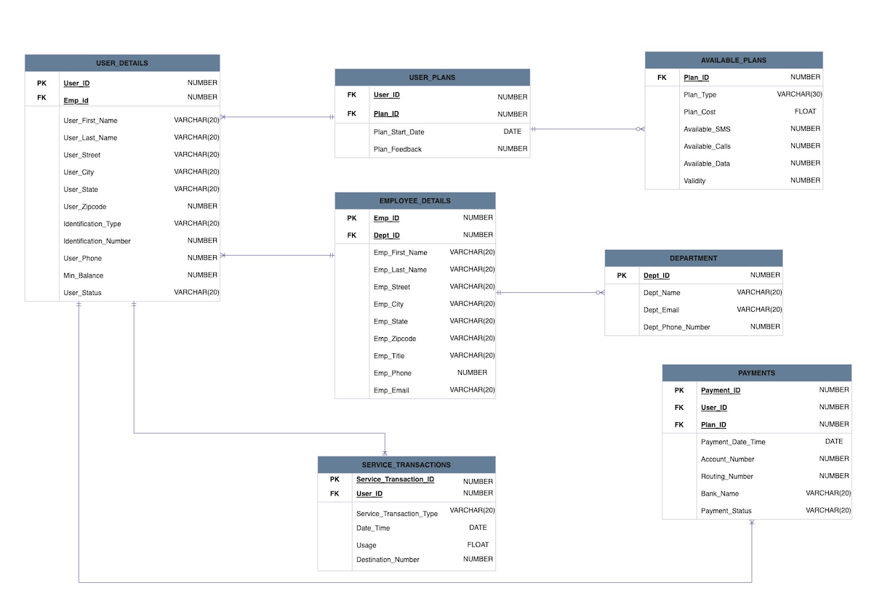

Slide 4
Network Provider Database Management System Design

Slide 5
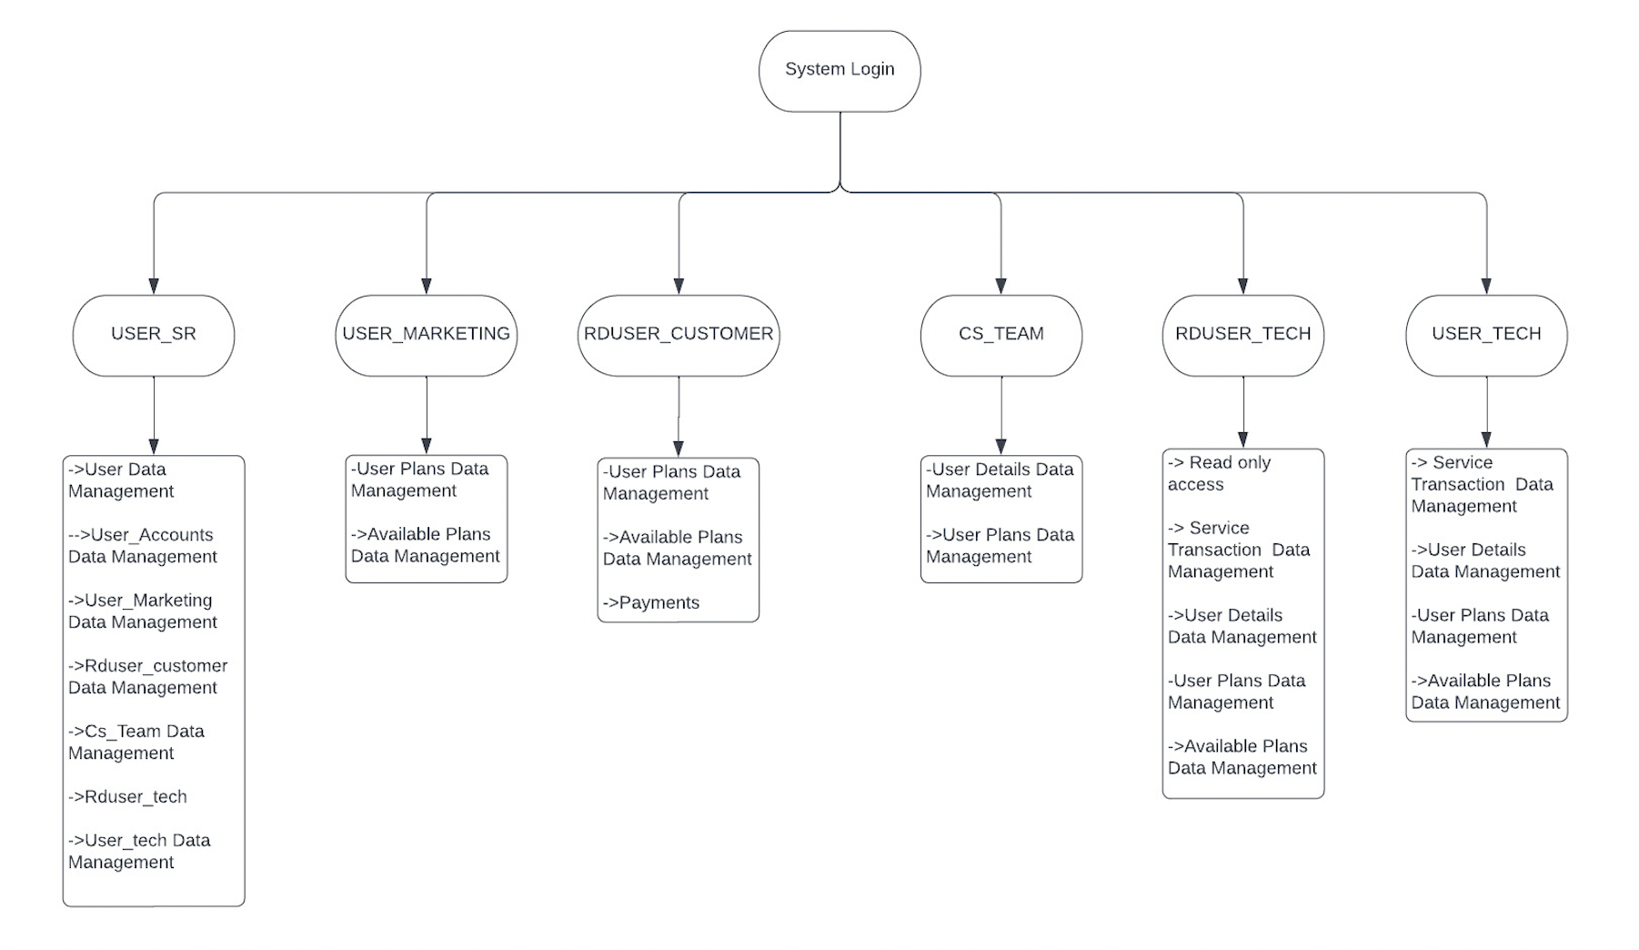

Slide 6
System Functionalities

Slide 7
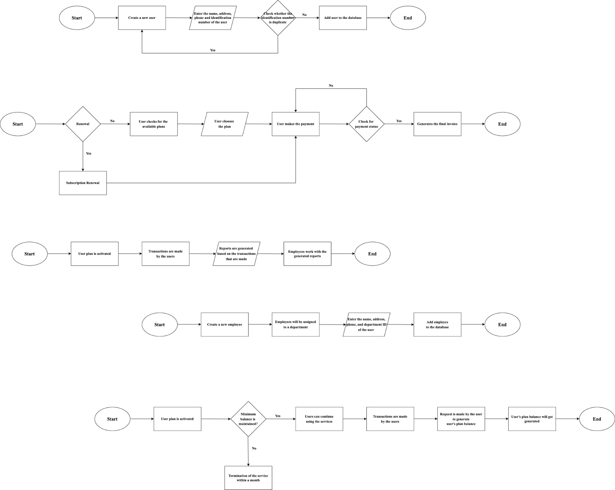
USER Module
EMPLOYEE Module

Slide 8
PLANS and PAYMENT Module
User’s Balance Module

Slide 9
Deliverables

Slide 10
Tables

Slide 11
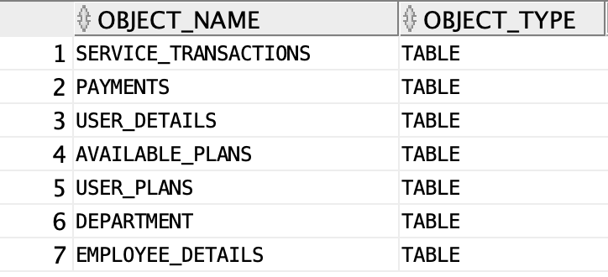

Slide 12
Views

Slide 13
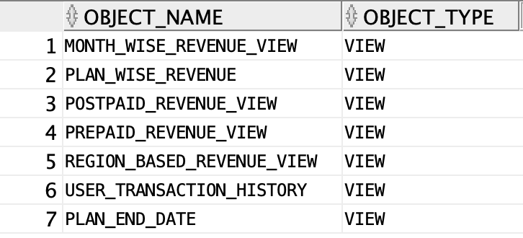

Slide 14
Indexes

Slide 15
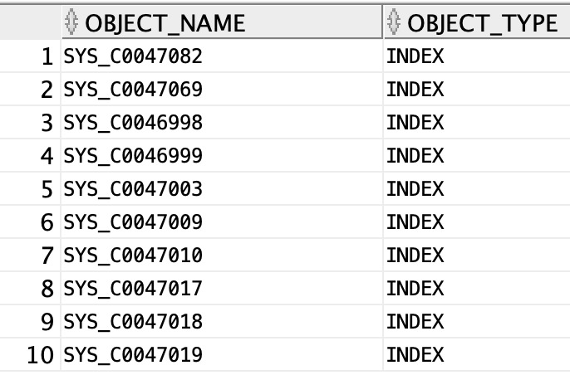

Slide 16
Triggers

Slide 17
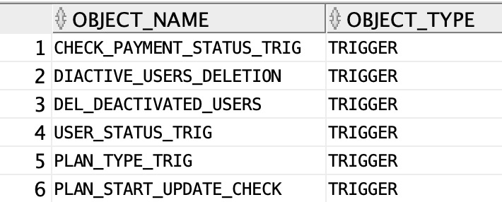

Slide 18
Stored Procedures, Functions, Packages & Sequences

Slide 19
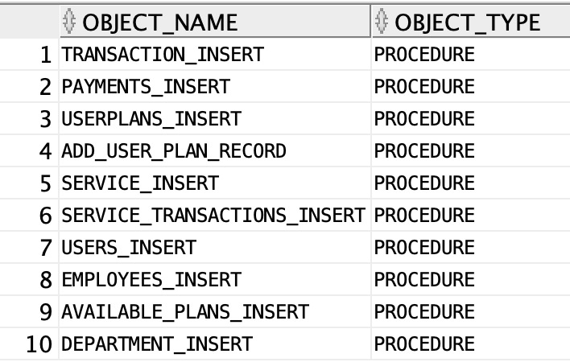
STORED PROCEDURES

Slide 20
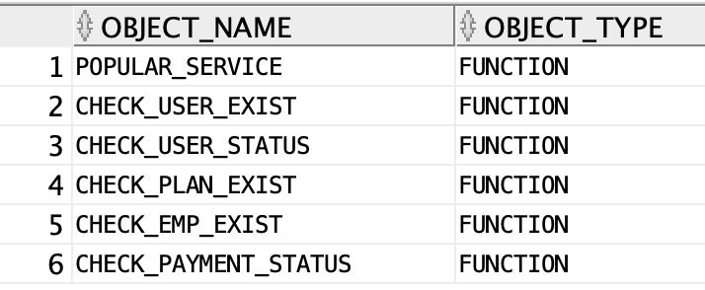
FUNCTIONS

Slide 21
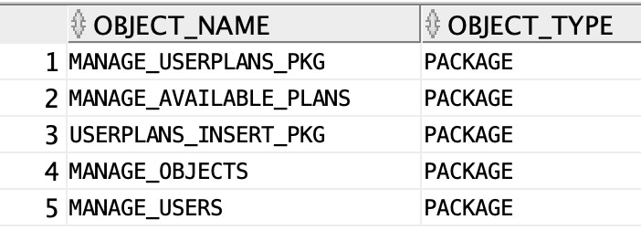
PACKAGES

Slide 22
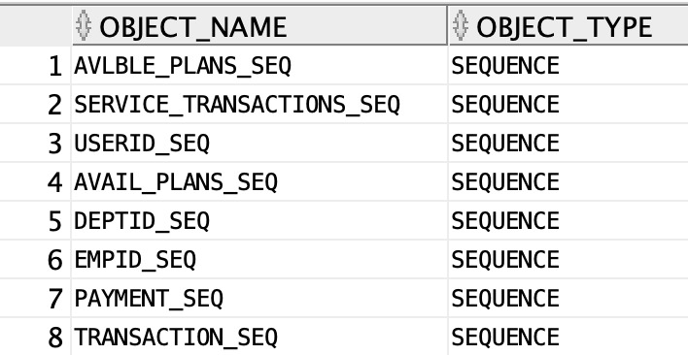
SEQUENCES

Slide 23
Thank You!

